Slide 1

Sequence Diagrams
Henry Tang
hktang@ualberta.ca
Department of Computing Science
University of Alberta
CMPUT 301 – Introduction to Software Engineering
Slides adapted from Dr. Hazel Campbell, Dr. Ken Wong, and Dr. Abram Hindle
Updated by Michelle Deng 2026
Images reproduced in these slides have been included under section 29 of the Copyright Act, as fair dealing for research, private study, criticism, or review. Further distribution or uses may infringe copyright.

Slide 2
Table of Contents
First Look at UML Sequence Diagram
Basic Notation
Use Cases
More Notation

Slide 3
First Look: UML Sequence Diagram
object
new
MyView
new
Button
activation box
constructor call
time
new
listener:MyListener
addActionListener(listener)
synchronous method call
actionPerformed( … )
lifeline
Notes:
From Dr. Campbell

Slide 4

Sequence Diagram Basic Notation
Object
Behaviour represented as interactions
Actor
Watch
Display
Time
WatchUser
pressButton1()
blinkHours()
pressButton1()
blinkMinutes()
pressButton2()
incrementMinutes()
Message
pressButton2()
refresh()
commitNewTime()
stopBlinking()
Activation
Lifeline

Slide 5
UML Sequence Diagrams Basic Notation
TicketMachine
Classes are represented by columns
Messages are represented by arrows
Activations are represented by narrow rectangles
Lifelines are represented by dashed lines
Passenger
selectZone()
insertCoins()
pickupChange()
pickUpTicket()

Slide 6
UML Sequence Diagrams – Use Cases
TicketMachine
Used during requirements analysis
  To refine use case descriptions
  To find additional objects (“participating objects”)
Used during system design
  To refine subsystem interfaces
Passenger
selectZone()
insertCoins()
pickupChange()
pickUpTicket()

Slide 7
More Notation
We will now cover
  Nested Messages and Data flow
  Iteration and Condition
  Creation and Destruction
  Combined Fragments
    Alternatives
    Option
    Loops

Slide 8
Nested Messages and Data Flow
ZoneButton
TariffSchedule
Display
Passenger
selectZone()
lookupPrice(selection)
price
TariffScheduler passes price
data to ZoneButton
Dataflow
displayPrice(price)
The source of an arrow indicates the activation which sent the message
An activation is as long as all nested activations
Horizontal dashed arrows indicate data flow
Vertical dashed lines indicate lifelines
Notes:
Example continues on following slide

Slide 9
Iteration and Condition
ChangeProcessor
CoinIdentifier
Display
CoinDrop
Passenger
*insertChange(coin)
lookupCoin(coin)
Iteration
price
displayPrice(owedAmount)
Condition
[owedAmount<0] returnChange(-owedAmount)
Iteration is denoted by a * preceding the message name
Condition is denoted by Boolean expression in [ ] before the message name
  Also known as a guard
Notes:
Example continued on following slide

Slide 10
Creation and Destruction
ChangeProcessor
Passenger
createTicket(selection)
Ticket
print()
Creation
free()
Destruction
X
Creation is denoted by a message arrow to the object
Destruction is denoted by an X mark at the end of the destruction activation
In garbage collection environments, destruction can be used to denote the end of the useful life of an object

Slide 11
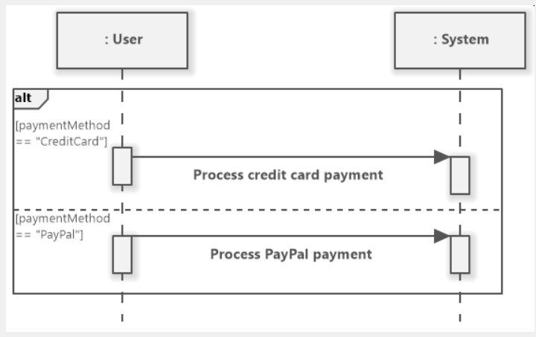
Combined Fragments: Alternative
Model mutually exclusive operands (cases)
  Only one operand will be true at a given time
  Works like an if – else if – else statement
https://www.softwareideas.net/sequence-diagram-opt-vs-alt

Slide 12
Combined Fragments: Alternative
Draw box around all operands; label box “alt” →
Dotted line to separate operands →
In this example,
the payment method
either is by credit card or
PayPal, never both.
https://www.softwareideas.net/sequence-diagram-opt-vs-alt

Slide 13
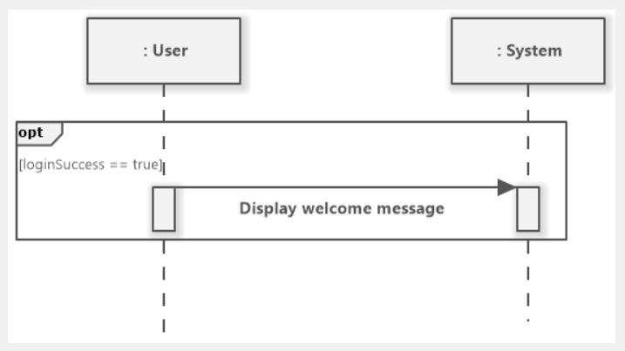
Combined Fragments: Optional
Model a single conditional path that is optional to run
Draw box around operand; label box “opt” →
In this example, we can choose to display the welcome message if we wanted to.
https://www.softwareideas.net/sequence-diagram-opt-vs-alt

Slide 14
Combined Fragments: Loops
Model repeated interaction given a condition
Condition types
  Iteration loops: repeat a fixed number of times
    [i &lt; 5]
  While loops: repeat while a condition is true
    [while balance > cost]
  For each loops: iterate over a collection/list
    [for each order item]
  Until loops: repeat until a specific event is happens
    [until success]
Notes:
Credit: https://creately.com/guides/uml-sequence-diagram-loop/

Slide 15
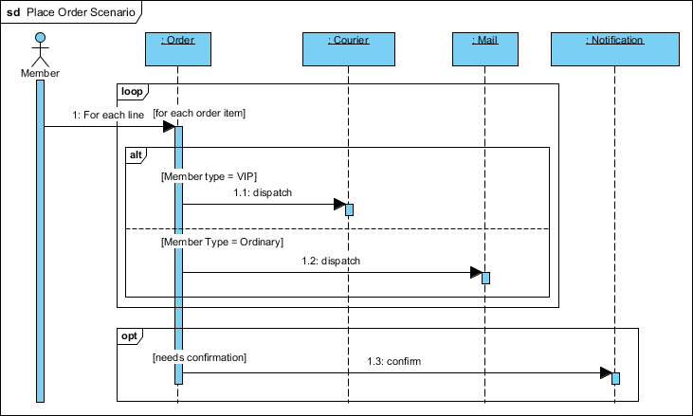
Combined Fragments: Loops
Draw box around part to iterate over; label box “loop”
Add condition
In this example, every item ordered will be checked if it will be delivered by courier or by mail
https://www.archimetric.com/what-is-sequence-diagram/

Slide 16
Sequence Diagram Summary
UML sequence diagrams represent behaviour in terms of interactions
Useful to find missing objects
Time consuming to build but worth the investment
Complements the class diagrams (which represent structure)

Slide 17
Let’s Practice Reading Sequence Diagrams

Slide 18
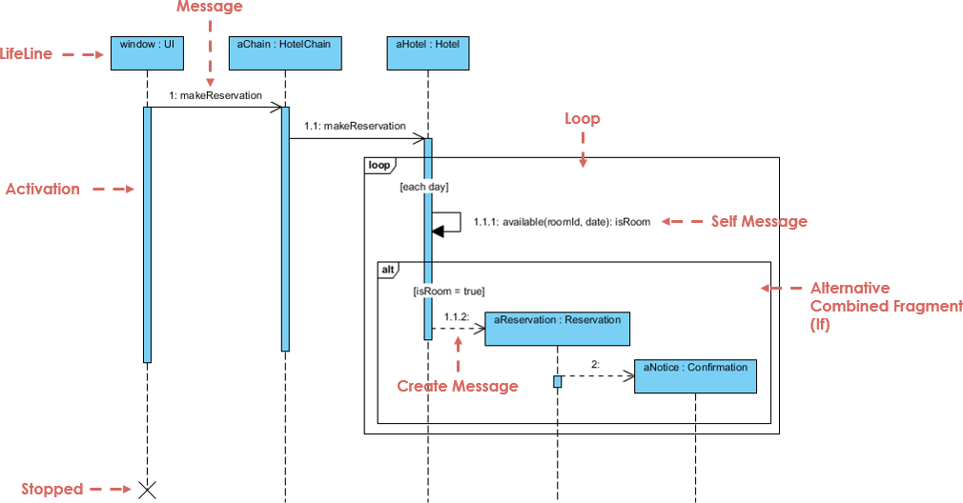
1
2
4
3
5
7
6
https://www.visual-paradigm.com/guide/uml-unified-modeling-language/what-is-sequence-diagram/

Slide 19
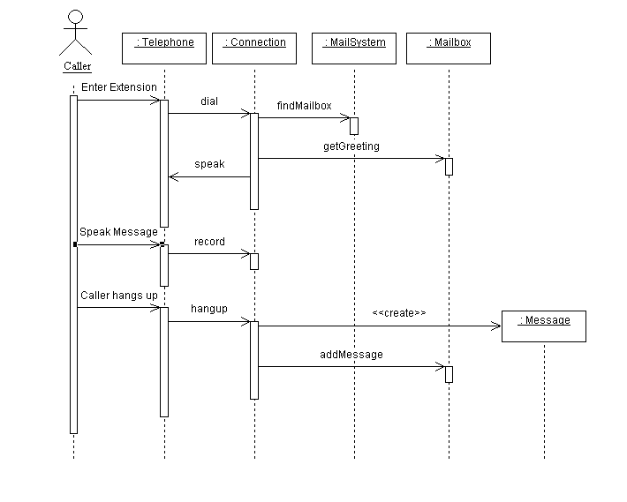
https://www.cs.fsu.edu/~myers/cop3331/notes/dynamicmodel.html

Slide 20
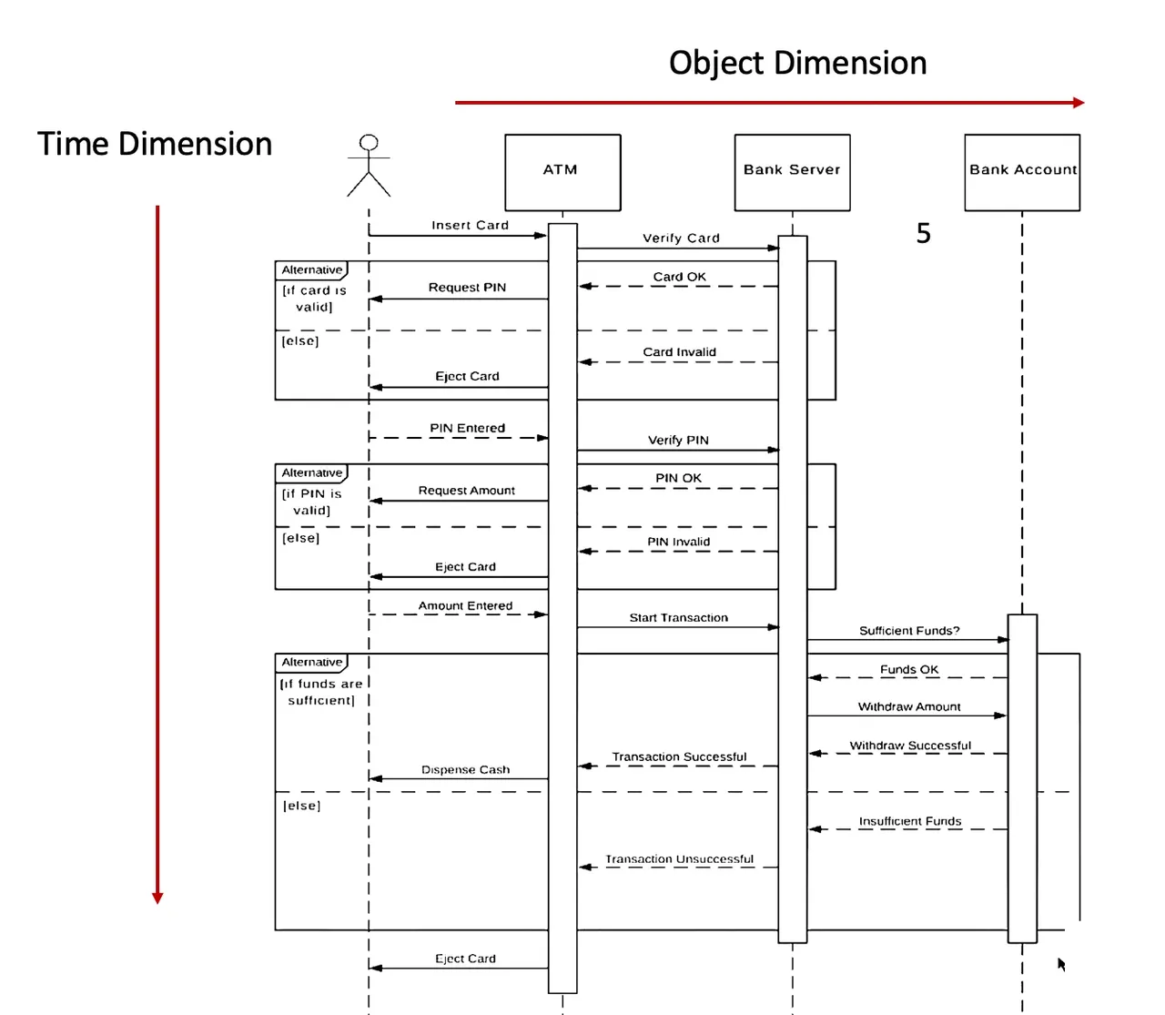
https://thebadoc.com/ba-techniques/f/sequence-diagrams-made-simple

Slide 21
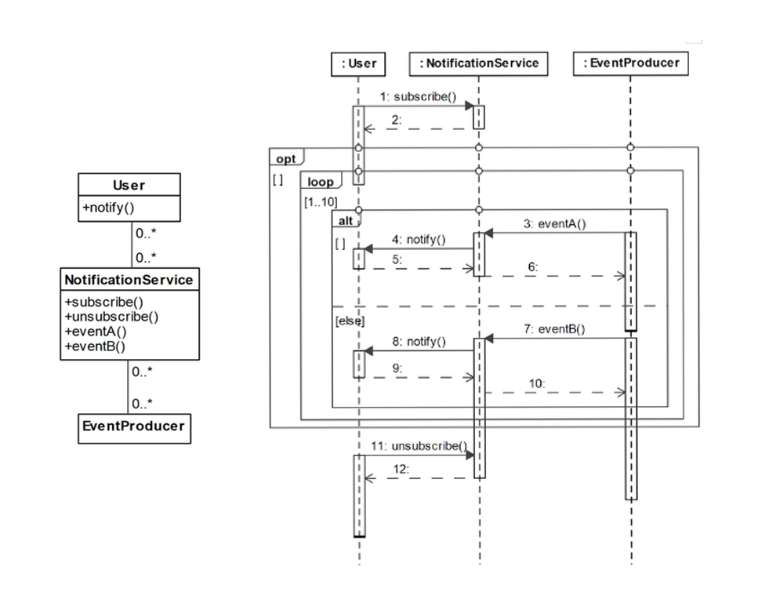
https://modeling-languages.com/wp-content/uploads/2020/06/03Fig.jpg

Slide 22
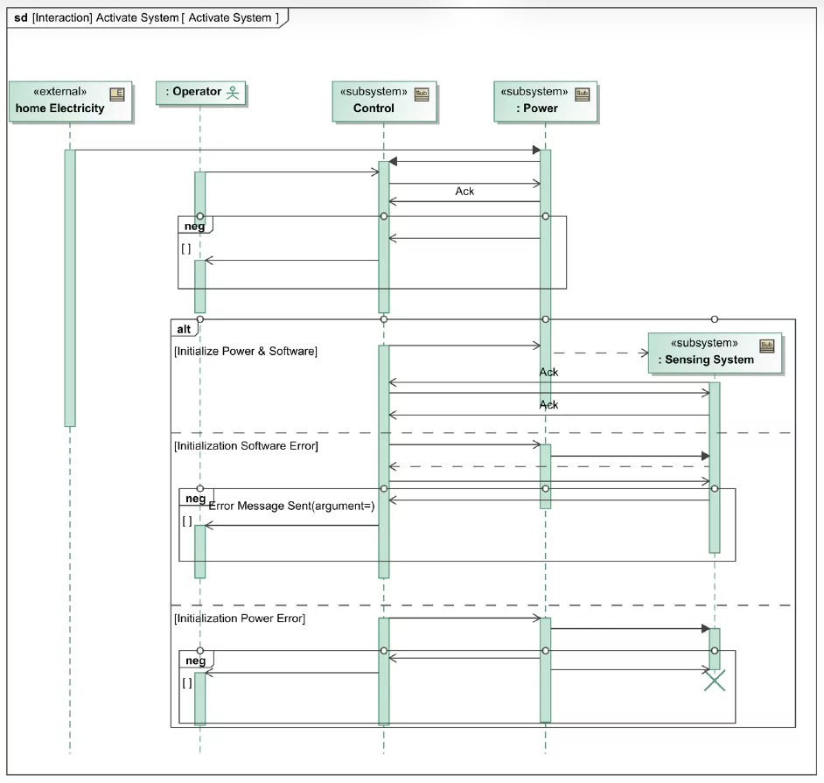
https://www.beyondmbse.com/wp-content/uploads/2022/12/sequence-diagram.png

Slide 23
Spot the Mistakes

Slide 24
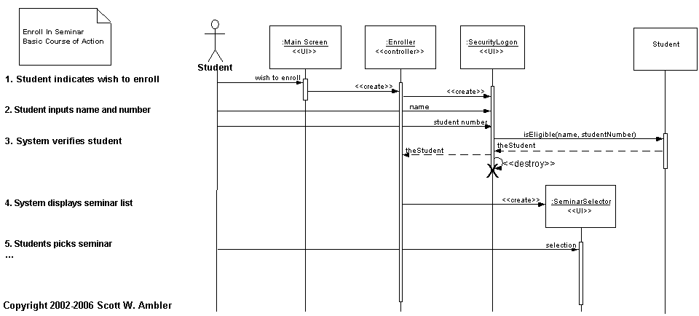
What’s Wrong with This One?
Only one create goes to the right place!
Lifelines should be dashed!
https://agiledata.org/essays/objectorientation101.html

Slide 25
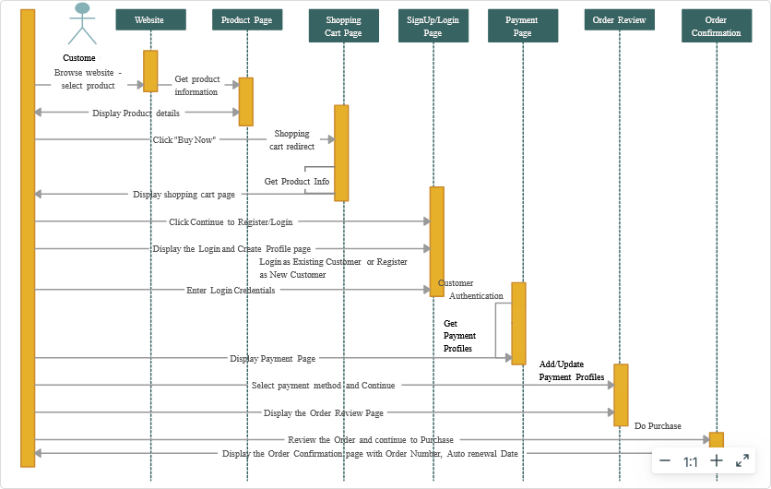
https://creately.com/diagram/example/i3069s4u1/sequence-diagram-online-shopping
Notes:
Actions are wrong

Slide 26
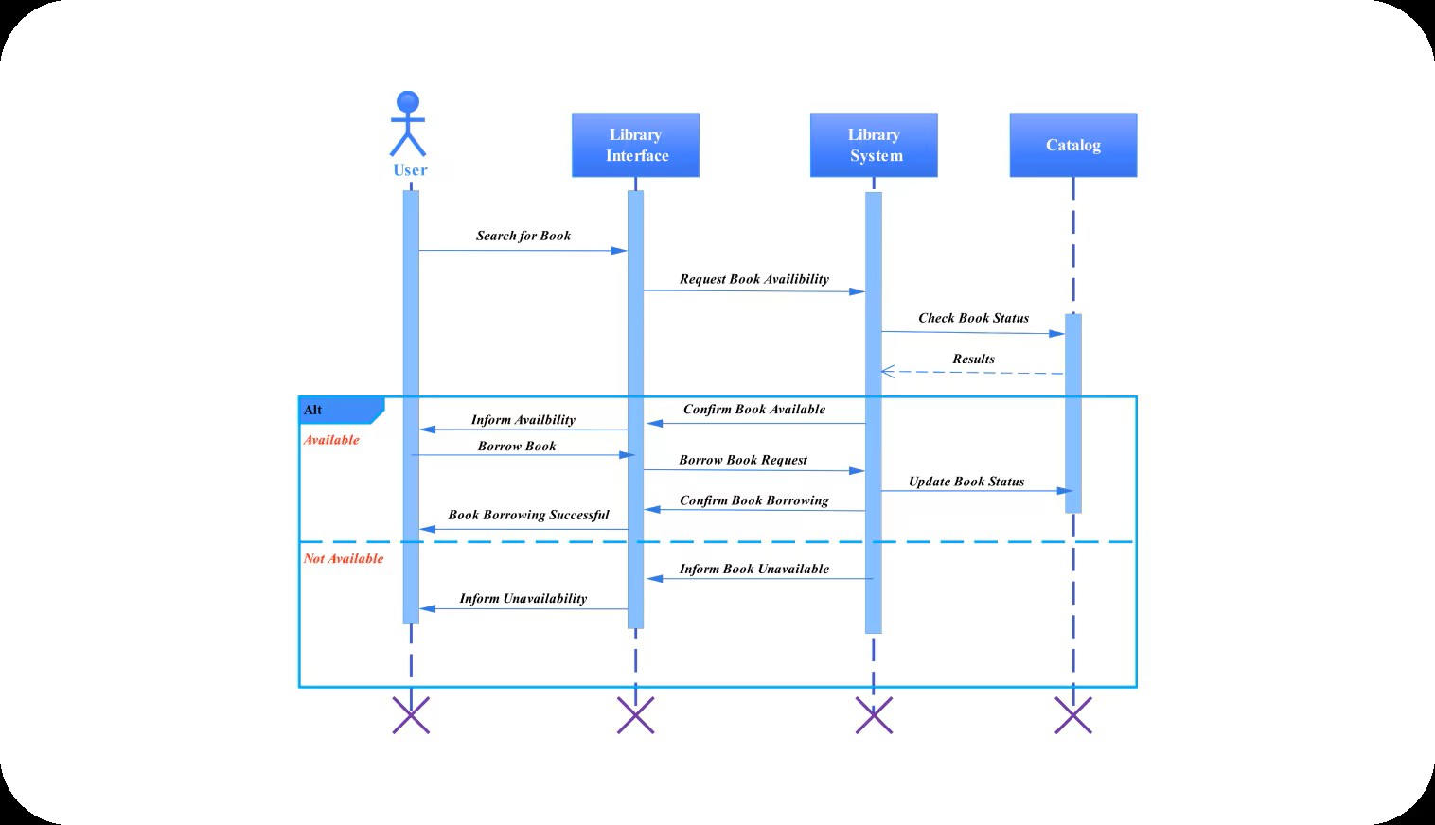
https://edrawmax.wondershare.com/templates/sequence-diagram-for-library-management-system.html
Notes:
Data flow needs to be dashed lines
User doesn’t get destroyed

Slide 27
More Information
The IBM Page on Sequence Diagrams:
https://developer.ibm.com/articles/the-sequence-diagram/

Slide 28
More Information
Links:
  UML 2 Sequence Diagrams
    http://agilemodeling.com/artifacts/sequenceDiagram.htm
  Wikipedia
    https://en.wikipedia.org/wiki/Sequence_diagram
  Other slides adapted from Larman et al.
    http://www.cse.lehigh.edu/~glennb/oose/ppt/06SystemSequenceDiagrams.ppt

